Slide 1

Chapter 7:
Time-Varying Fields and
Maxwell’s Equations
Lecturer: Nana Liu
Summer 2020
Many slides courtesy of Sung-Liang Chen

Slide 2
Everything you need to know
about time-varying fields
and Maxwell’s equations
in this course…

Slide 3

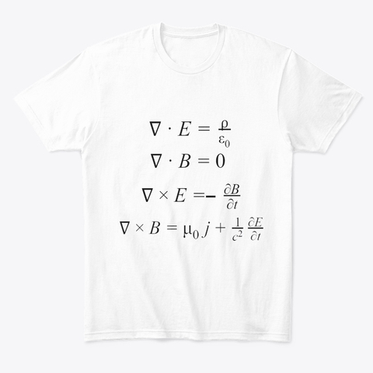
Yay!!!
Finally the whole T-shirt!!!

Slide 4
Main parts in time-varying fields:
(I) Modifying 2 Maxwell’s equations away from static case: moving currents and magnets
(II) Electromagnetic waves
(III) Electromagnetic boundary conditions
(IV) Solutions for wave equations

Slide 5

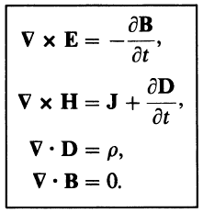


Maxwell’s Equations

Slide 6
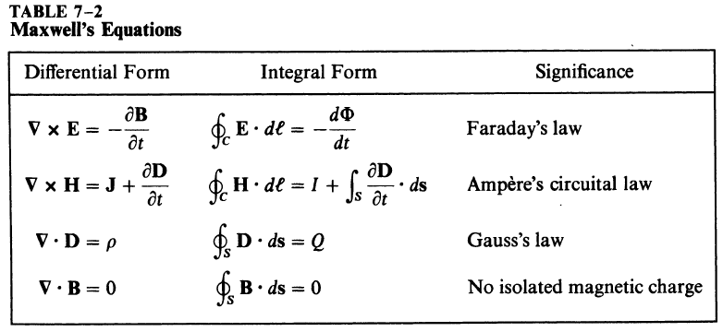
Maxwell’s Equations

Slide 7
Time-varying fields scenarios:
Static circuit in moving B field
Moving conductor in static B field
Circuit and B field both in motion

Slide 8

Time-varying fields scenarios:
EMF

Slide 9
Maxwell’s Equations

Slide 10


Vector and scalar potentials

Slide 11










Vector and scalar potentials
Poisson’s equations (static cases)
Wave equations (time-varying cases)

Slide 12


Source-free wave solutions
Homogeneous vector wave equations

Slide 13




Boundary conditions

Slide 14



7-1 Introduction
Electrostatics:
Magnetostatics:
For linear and isotropic media
For linear and isotropic media

Slide 15
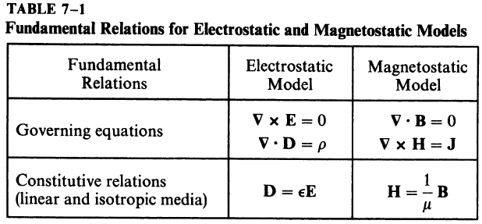

Slide 16
Static Case
(E and D) and (B and H) form separate and independent pairs.
Electromagnetostatic field: in a conducting medium, static E ➔ static J ➔ static B.
Static electric and static magnetic fields both exist.
B is a consequence, not affecting E

Slide 17
Time-varying Case
(E and D) and (B and H) are related.
A changing magnetic field gives rise to an electric field, and vice versa.
Table 7-1 must be modified.

Slide 18

7-2 Faraday’s Law of Electromagnetic Induction
Faraday’s law: the quantitative relationship between the induced emf and the rate of change of flux linkage, based on experimental observation (emf = −dΦ/dt).
Fundamental postulate for electromagnetic induction:
Applies whether it be in free space or in a material medium
The electric field intensity in a region of time-varying magnetic flux density is therefore nonconservative and cannot be expressed as the gradient of a scalar potential

Slide 19

Surface integral over an open surface
Stokes’ theorem
Integral form

Slide 20
Several Cases
A stationary circuit in a time-varying magnetic field (transformer emf)
A moving conductor in a static magnetic field (motional emf)
A moving circuit in a time-varying magnetic field (combined)

Slide 21

7-2.1 A Stationary Circuit in a Time-Varying Magnetic Field
For a stationary circuit with a contour C and surface S
Define
Stationary S (i.e., S not a function of time)
C may or may not be a physical circuit

Slide 22

Then,
The induced emf will cause a current to flow in the closed loop in such a direction as to oppose the change in the linking magnetic flux. (Lenz’s law)
Faraday’s law of electromagnetic induction: The emf induced in a stationary closed circuit is equal to the negative rate of increase of the magnetic flux linking the circuit. (Transformer emf)

Slide 23
Example

Slide 24
Example

Slide 25
Example

Slide 26
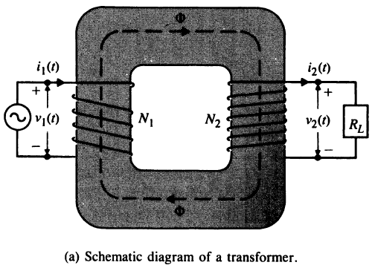
7-2.2 Transformers
A transformer: two or more coils coupled magnetically through a common ferromagnetic core.

Slide 27



Primary circuit
Secondary circuit
KVL for magnetic circuit:
By Lenz’s law, the induced mmf, N₂i₂, opposes flux Φ created by the mmf in the primary circuit, N₁i₁.

Slide 28

Ideal transformer
Assume μ → ∞,
The ratio of the currents in the primary and secondary windings of an ideal transformer is equal to the inverse ratio of the numbers of turns.

Slide 29



From Faraday’s law:
The ratio of the voltages across the primary and secondary windings of an ideal transformer is equal to the turns ratio.

Slide 30
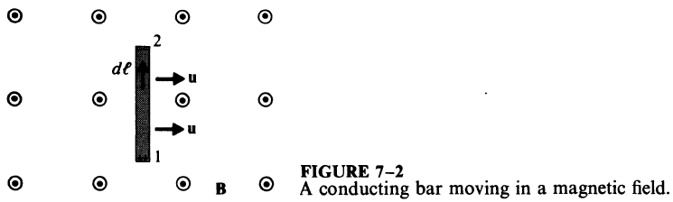
7-2.3 A Moving Conductor in a Static Magnetic Field
−
F_{m}=qE_{m}
F_{e}=qE_{induced}
+
A magnetic force
Moving velocity of a conductor
Static magnetic field
F_{m} (magnetic force) ➔ charge separation ➔ E_{induced} ➔F_{e} (electric force)
At equilibrium, the net force (F_{m}+F_{e}) on the free charges in the moving conductor is zero.

Slide 31


−
F_{m}=qE_{m}
F_{e}=qE_{induced}
+
An induced electric field acting along the conductor and producing a voltage
−E_{induced}=E_{m}=u×B
If the moving conductor is a part of a closed circuit C, the emf
Called flux cutting emf or motional emf
For u//B (no flux is cut), emf V’=0

Slide 32
7-2.4 A Moving Circuit in a Time-Varying Magnetic Field
Transformer emf + motional emf
Lorentz’s force equation:
The effective electric field E’ on q:
Due to time-varying magnetic field (transformer emf)
Due to a moving circuit (motional emf)

Slide 33


Considering a conducting circuit with contour C and surface S moves with a velocity u in a field (E,B):
Integral along C
and use
General form of Faraday’s law for a moving circuit in a time-varying magnetic field.
(34)
Transformer emf
Motional emf

Slide 34
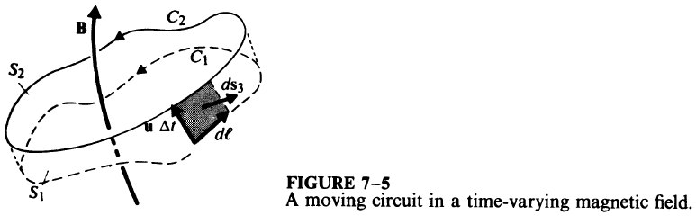
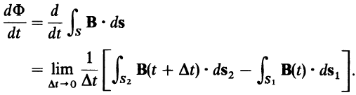
A Moving Circuit
Moving velocity: u
The contour C moves from C₁ at time t to C₂ at time t+Δt
The motion can be translation, rotation, and distortion in an arbitrary manner.

Slide 35

(1)
Expand this term B(t+Δt) as a Taylor’s series
(2)
(4)
(3)
(37)
(2)
(1)
(4)
(3)

Slide 36


ds₂
ds₁
In going from C₁ to C₂, the circuit covers a region bound by S₁, S₂, and S₃.
S₃: side surface, the area swept out by the contour in time Δt. An element of S₃
Apply the divergence theorem for B at time t
Because outward normal must be used

Slide 37


0
A⋅(B×C) = B⋅(C×A)
(40)

Slide 38



Combine Eqs. (37) and (40)
(37)
(40)
H.O.T is neglected as Δt→0
Compared with (34)
−

Slide 39

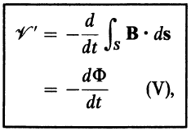
−
By designating
(43)

Slide 40
Comparison of Eqs. (43) and (6)
(43)
(6)
They are exactly the same.
V’ is for circuits in motion; V is for circuits not in motion
Faraday’s law that the emf induced in a closed circuit equals the negative time-rate of increase of the magnetic flux linking a circuit applies to a stationary circuit as well as a moving one.

Slide 41
Example

Slide 42
Example

Slide 43
Example

Slide 44
Example

Slide 45
Example

Slide 46
Example

Slide 47

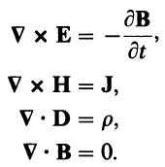
7-3 Maxwell’s Equations
Electromagnetic induction: a time-varying magnetic field gives rise to an electric field.
Static case
Time-varying case

Slide 48

Modification of ∇×H=J in a Time-varying Case
Charge conservation (or the equation of continuity) must be satisfied at all times
Check if ∇×H=J is consistent with the requirement of charge conservation in a time-varying situation
By null identity

Slide 49





Not consistent!
Since ∇⋅J=0 does not vanish in a time-varying situation (or ρ is changing in a time-varying situation), ∇⋅J=0 is in general not true.
➔ ∇×H=J should be modified in a time-varying situation
In order to satisfy
➔

Slide 50


Thus, a time-varying electric field will give rise to a magnetic field, even in the absence of a current flow.
A short summary:
To satisfy charge conservation
Displacement current density
(Introduced by James Clerk Maxwell)

Slide 51
Maxwell’s Equation
ρ: free charge
J: free currents (including convection current (ρu) and conduction current (σE))
The above 6 equations form the foundation of electromagnetic theory!

Slide 52
Electromagnetic Problem
4 unknowns: E, D, B, H
4 independent equations
(1) and
(2)
(3)
(4)

Slide 53




7-3.1 Integral Form of Maxwell’s Equations
Surface integral
Stokes’ theorem
Volume integral
Divergence theorem

Slide 55




7-4 Potential Functions
divergenceless
or

Slide 56




curl free
Due to charge distribution ρ → V
Due to time-varying current J → A
V and A here are solutions of Poisson’s equations

Slide 57
Quasi-static Fields
The two equations were obtained under static conditions
They can be time dependent: ρ(t), J(t) ➔ V(t), A(t)
If ρ and J vary slowly with time and the range of interest R is small in comparison with the wavelength (low frequency, long wavelength), it is allowable to use the 2 equations to find quasi-static fields.

Slide 58
Time-retardation Effects
Quasi-static fields are approximations.
When the source frequency is high, quasi-static solutions will not suffice. Time-retardation effects must be included. (Discussed in 7-6)

Slide 59
ρ=ρ₀sin(ωt)
ρ₀
a
a
V(a)
V(a)
ρ
ρ
t
t
Time-retardation effects for high-frequency sources
As the source changes in time, it takes time to change the potential at a certain distance from the source!

Slide 60





∇×B=
Assume a homogeneous medium
Vector identity
or

Slide 61


A vector requires the specification of both its curl and its divergence.
Curl has been specified
How to choose divergence!?
We let
Lorentz condition (or Lorentz gauge) for potentials
Also, the condition is consistent with equation of continuity (P7-12)
Nonhomogeneous wave equation for vector potential A
Reduced to Poisson’s equation for static cases
Its solutions represent waves traveling with a velocity (Discussed more in 7-6)

Slide 62





Nonhomogeneous wave equation for scalar potential V
Assume a constant ε
Lorentz condition uncouples the wave equations for A and V
Reduced to Poisson’s equation in static cases
Its solutions represent waves traveling with a velocity

Slide 63
Solution of Wave Equations for A and V
Poisson’s equations (static cases)
Solutions
Wave equations (time-varying cases)
Solutions ?
Different equations ➔ solutions must be modified! (Discussed more in 7-6)

Slide 64
7-5 Electromagnetic Boundary Conditions
In general, the application of the integral form of a curl equation to a flat closed path at a boundary with top and bottom sides in the two touching media yields the boundary condition for the tangential components
The application of the integral form of a divergence equation to a shallow pillbox at an interface with top and bottom faces in the two contiguous media gives the boundary condition for the normal components

Slide 65
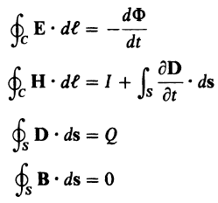
h
For curl equations:
Let the height of the flat closed path approach zero (area → 0)
➔ The surface integral of ∂B/∂t and ∂D/∂t vanishes
➔ Same as equations for static electric and static magnetic fields

Slide 66
(2)
(3)
The tangential component of an E field is continuous across an interface
The tangential component of an H field is discontinuous across an interface where a surface current exists, the amount of discontinuity being determined by Eq. (2)
The normal component of a D field is discontinuous across an interface where a surface charge exists, the amount of discontinuity being determined by Eq. (3)
The normal component of a B field is continuous across an interface

Slide 67
Due to the dependence of Maxwell’s equations, divergence equations can be derived from curl equations and equation of continuity.
Equivalent BC
Equivalent BC

Slide 68

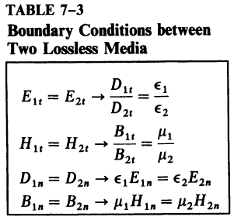
7-5.1 Interface between Two Lossless Linear Media
A lossless linear media: ε, μ, σ=0
J=0 ➔ power dissipation = 0 ➔ lossless
Usually no free charges and no surface currents at the interface of two lossless media. (ρ_{s}=0, J_{s}=0)

Slide 69
7-5.2 Interface between a Dielectric and a Perfect Conductor
Conductors
Good conductors: σ ~ 10⁷ (S/m)
Superconductors: σ ~ 10²⁰ (S/m)
In order to simplify the analytical solution of field problems, good conductors are often considered perfect conductors in regard to boundary conditions.

Slide 70

Perfect Conductors
σ → ∞
E_{inside} = 0 (otherwise, infinite J inside)
Charges only reside on the surface
In a time-varying situation, (E, D) and (B, H) in the interior of a conductor are zero.
E=0 → D=0
E=0 → B(t)=0 B=0 → H=0
In a time-varying situation, B should be time varying (i.e., cannot be a nonzero constant)!
in the static case, B and H may not be zero!

Slide 71
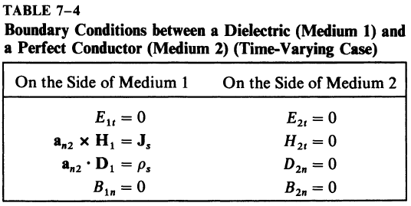
In medium 2 (a perfect conductor), E₂=0, H₂=0, D₂=0, B₂=0
Q: How about if medium 2 is a conductor with finite conductivity?
A: As mentioned in Section 6-10, currents in media with finite conductivities are expressed in terms of volume current densities J, and surface current densities J_{S} for currents flowing through an infinitesimal thickness (t) is zero.
J_{s}=J*t=0 as t→0 (t: thickness)
H_{t} continuous

Slide 72
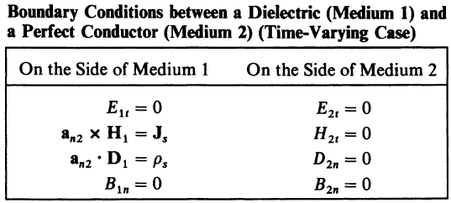
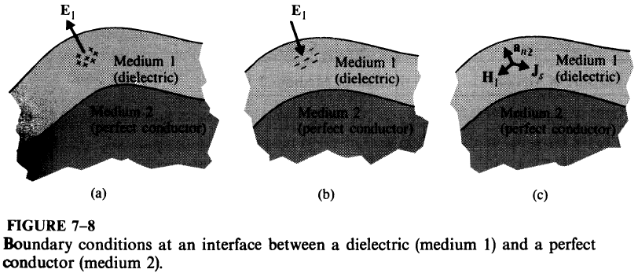


E_{1t}=0 ➔ E is normal to the points away from (into) the conductor surface when the surface charges are positive (negative)

Slide 73
Importance of Boundary Conditions
Maxwell’s equations are partial differential equations. Their solutions will contain integration constants that are determined from the additional information supplied by boundary conditions so that each solution will be unique for each given problem.

Slide 74
7-6 Wave Equations and Their Solutions
Importance of Maxwell’s equations
Give a complete description of the relation between electromagnetic fields and charge and current distributions (sources).
Their solutions provide the answers to all electromagnetic problems.
For given charge and current distributions
ρ
J
V
A
E, B

Slide 75

7-6.1 Solution of Wave Equations for Potentials
Nonhomogeneous wave equation
Finding V for an elemental point charge at time t located at the origin
Spherical symmetry → V(R,t) is only function of R
Except at origin, the wave equation

Slide 76



(7-71)
Introduce a new variable U
A 1D homogeneous wave eq.
Solution, which can be verified by direct substitution
(7-74)
“+” solution doesn’t satisfy causality and thus is neglected. (Discussed later.)

Slide 77


Check the function U at R+ΔR at a later time t+Δt
The function retains its form If
Thus, the function U(R,t) represents a wave traveling in the positive R direction with a velocity u = ΔR/Δt =

Slide 78


Slide 79





Next, to determine the specific function
A static point charge ρ(t)Δv’ at origin
Comparison with
Incorporate the retardation effect !
R
Potential due to a charge distribution
(integration)

Slide 80
The value of ρ at an earlier time (t−R/u)
➔ V(R,t) at a distance R from the source at time t
It takes time R/u for the effect of ρ to be felt at distance R.
That is, there is time retardation (Δt = R/u) from ρ to V
V(R,t)
R=uΔt
ρ
Q: can you explain now why “+” cannot be a solution?
A: it would lead to the impossible situation that the effect of ρ would be felt at a distant point before it occurs at the source. (or “+” solution doesn’t satisfy causality.)

Slide 81
Wave equation
Wave equation
Following exactly the same way as that for V
Retarded V
Retarded A

Slide 82
E or B obtained from V and A will also be functions of (t−R/u) and therefore retarded in time.
It takes time for electromagnetic waves to travel and for the effects of time-varying charges and currents to be felt at distant points.
In the quasi-static approximation we ignore this time-retardation effect and assume instant response.

Slide 83
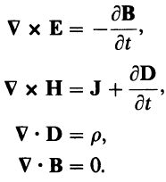
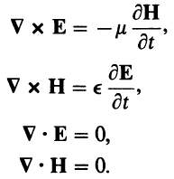
7-6.2 Source-Free Wave Equations
Source free: ρ=0, J=0
Often interested not so much in how an electromagnetic wave is originated, but in how it propagates.
Assuming a simple nonconducting media characterized by ε and μ (σ=0),
D=εE
B=μH

Slide 84





Curl on both sides
substitute
In an entirely similar way,
.
.
.
Homogeneous vector wave equations

Slide 85

Homogeneous vector wave equations
In Cartesian coordinates, the above equations can be decomposed into three 1D wave equations, just like the equation (7-73) solved before
Thus, each component of E and H also represents waves, just like U.

Slide 86
7-7 Time-Harmonic Fields
Since Maxwell’s equations are linear differential equations, sinusoidal time variations of source functions of a given frequency will produce sinusoidal variations of E and H with the same frequency in the steady state.
For source functions with an arbitrary time dependence, electrodynamic fields can be determined in terms of those caused by the various frequency components of the source functions. The applications of superposition will give us the total fields.
analyze various frequency component ➔ use superposition to get the total field

Slide 87
Source: f₁
Linear system
Field: f₁
f₁
Linear system
f₁
f₂
f₂
Source
f₃
f₃
Field
.
.
.
.
.
.
decomposition
superposition

Slide 88

7-7.1 The Use of Phasors—A Review
Choose either a cosine or sine function as the reference
Specify 3 parameters: amplitude, frequency, and phase

Slide 89



Example
Time domain
The loop equation for a series RLC circuit. Determine i(t)?
Applied voltage
Complicated mathematical manipulations are required to determine I and φ

Slide 90






Example
Relation between time-domain and phasor expression
s(t)=Re[Se^{jωt}]
Phasor domain
The loop equation for a series RLC circuit. Determine i(t)?
I. Change to phasor expressions
Applied voltage
Phasors
Phasors contain amplitude and phase information but are independent of t
II. Differentiation and integration
III. Equation in phasor domain
I_{s} can be solved easily.

Slide 91


7-7.2 Time-Harmonic Electromagnetics
Vector phasors: e.g., a time-harmonic E field
direction, magnitude, and phase
Differentiation and integration
∂/∂t ➔ jω

Slide 92
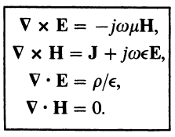
Maxwell’s equations in terms of vector field phasors (E, H) and source phasors (ρ, J) in a simple (linear, isotropic, and homogeneous) medium
Time-dependent quantities and phasors have the same notations for simplicity.
In the rest of this book, we deal with phasors unless otherwise specified. (Useful note: any quantity containing j must necessarily be a phasor. Any quantities with t must be time-dependent quantities.)
Phasor quantities are not functions of t.

Slide 93











Time-harmonic wave equations
The Lorentz condition
The phasor solutions for wave equations
where
= 2π/λ
(the wavenumber)
e^{jω(t-R/u)}=e^{jωt}×e^{-jωR/u}=e^{jωt}×e^{-jkR}
Time delay (time domain) → additional phase term (phasor domain)

Slide 94



Taylor series expansion of the additional phase term e^{-jkR}
When R<<λ (or slow variation), e^{-jkR} →1
The solutions for V and A simplify to the static expressions.

Slide 95




Procedure for Determining E and H due to Time-harmonic ρ and J
1. Find V and A
2. Find E and B
3. Find instantaneous E(t) and B(t)

Slide 96
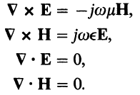




7-7.3 Source-Free Fields in Simple Media
In a simple, nonconducting source-free medium: ρ=0, J=0, σ=0
Method 1
Method 2
Homogeneous vector Helmholtz’s equations

Slide 97




If the medium is conducting (σ≠0), J=σE≠0, Eq. with J should be changed.
where
Complex permittivity
If complex permittivity ε_{c} is used, all the previous equations for nonconducting media can be applied to conducting media.

Slide 98

Loss
Damping loss: due to out-of-phase polarization
E is too quick, P is out of phase to E
Ohmic loss: due to free charge carries
The damping and ohmic losses can be characterized in the imaginary part of a complex permittivity ε_{c} (Chap. 8):
For an appreciable amount of free charge carriers, ohmic losses dominate and damping losses are very small and already neglected
Comparing

Slide 99


Low-loss or lossless media: ε_{c}=ε’
Lossy media: ε_{c}=ε’−jε’’
Loss tangent: a measure of power loss
The real wavenumber k should be changed to a complex wavenumber k_{c} in a lossy dielectric medium
: loss angle

Slide 100
A good conductor and a good insulator
A good conductor: σ>>ωε
A good insulator: ωε>>σ
Thus, a material may be a good conductor at low frequencies but may have the properties of a lossy dielectric at very high frequencies.
E.g., moist ground is a relatively good conductor at low frequency and behaves more like an insulator at high frequency.

Slide 101

7-7.4 The Electromagnetic Spectrum
Maxwell’s equations, and therefore the wave and Helmholtz’s equations, impose no limit on the frequency of the waves.
All electromagnetic waves in whatever frequency range propagate in a medium with the same velocity:

Slide 102
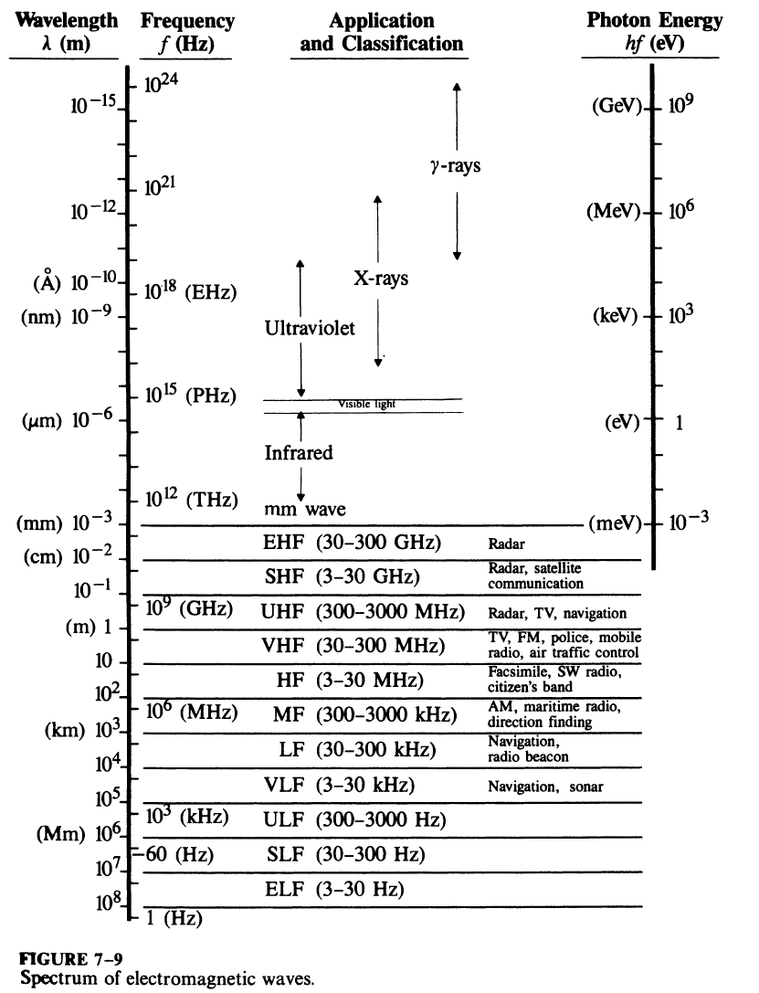

Slide 103
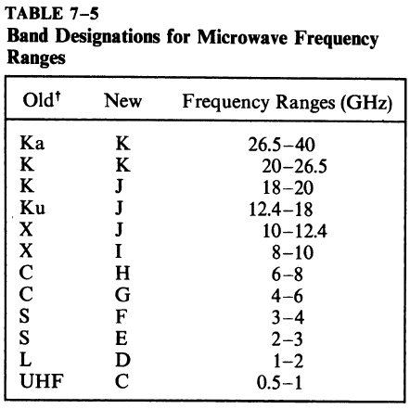

Slide 104
Extra slides

Slide 105


When the secondary winding is terminated in a load resistance R_{L}, the effective load seen by the source

Slide 106

For a sinusoidal source v₁(t) and a load impedance Z_{L}, the effect load seen by the source

Slide 107
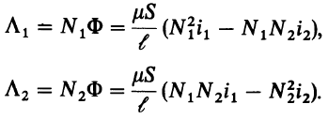
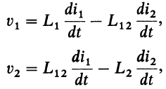



Replace Φ
Total flux
Substitution of Λ₁ Λ₂ in
where
Self-inductance of the primary winding
Self-inductance of the secondary winding
Mutual inductance

Slide 108


(b) Real transformer
For an ideal transformer:
Infinite μ → infinite L
For a real transformer:
k: coefficient of coupling

Slide 109
A real transformer
Leakage flux (k<1)
Noninfinite inductances
Nonzero winding resistances
Hysteresis
Eddy-current losses
μ(H)
➔ An exact analysis is difficult.

Slide 110
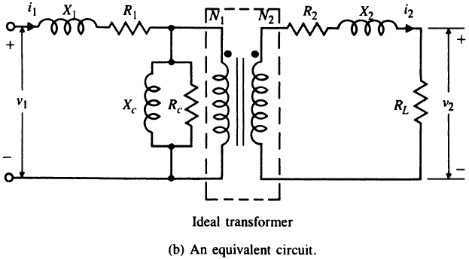
Leakage flux (k<1) (X₁, X₂ leakage inductive reactances)
Nonzero winding resistances (R₁, R₂ winding resistances)
Hysteresis (R_{c}, power loss)
Eddy-current losses (R_{c}, power loss)
μ(H) (X_{c}, nonlinear magnetization behavior)
Difficult to analyze…

Slide 111

Eddy Current
By Lenz’s law, an eddy current creates a magnetic field that opposes the magnetic field that created it, and thus eddy currents react back on the source of the magnetic field.
i_{Eddy}
Local currents in the conducting core (normal to Φ)
Ohmic power loss (local heating)
One way to reduce undesired eddy-current power loss: high μ low σ for core materials
High μ → less reluctance
Low σ → less current
less power loss

